Slide 1
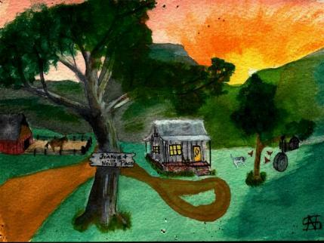

Slide 2
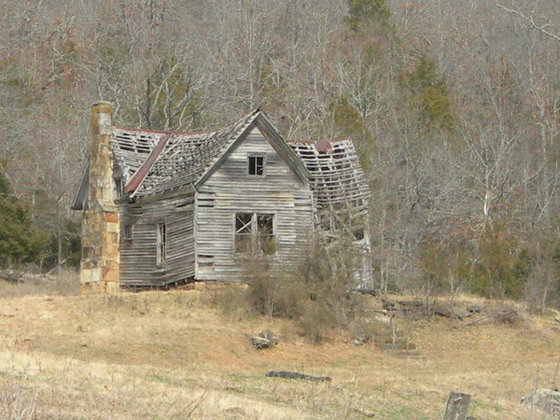
Homestead in the Hills
Living on Less and LOVING It

Slide 3
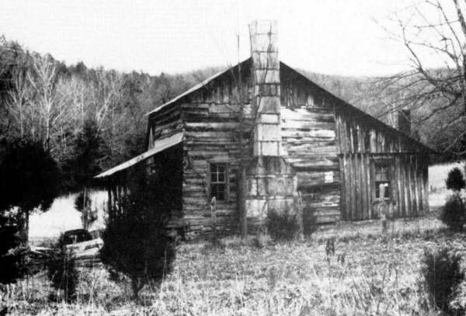

Slide 4
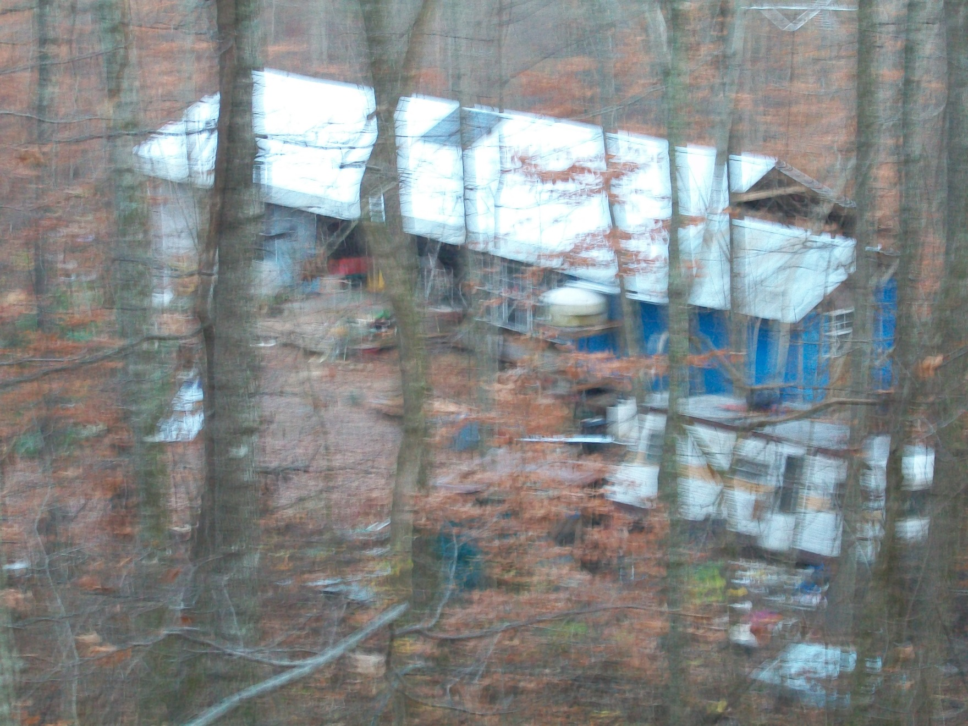

Slide 5
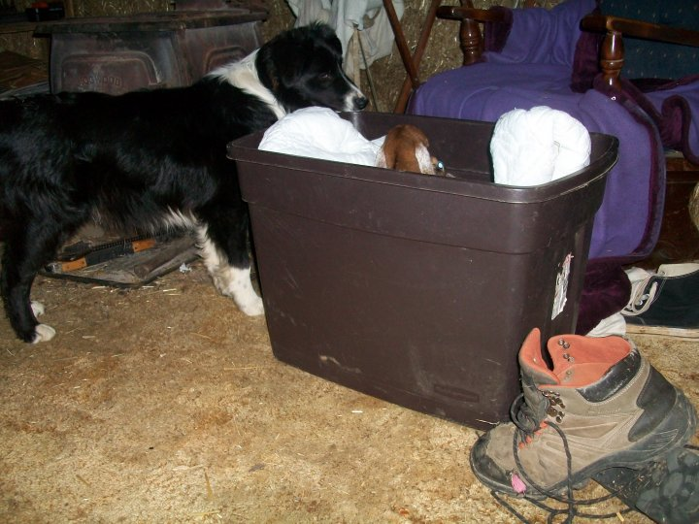

Slide 6
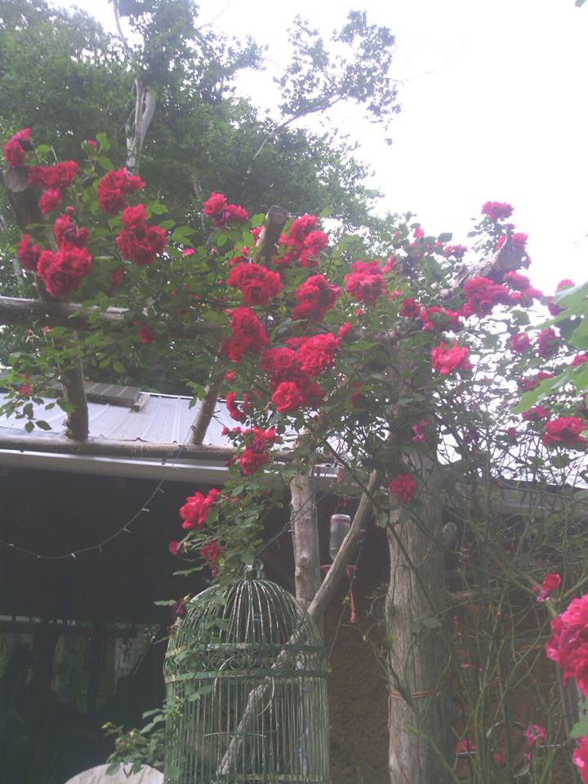

Slide 7
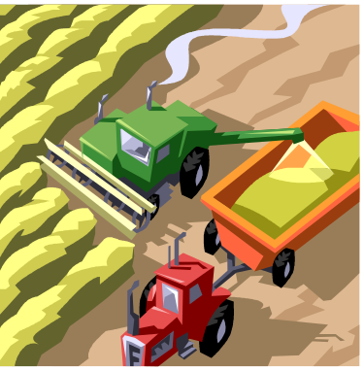
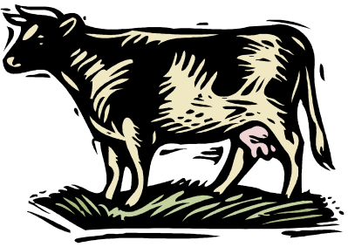
Homestead vs. Farm or Ranch
A farm or ranch is aimed at producing for sale.

Slide 8
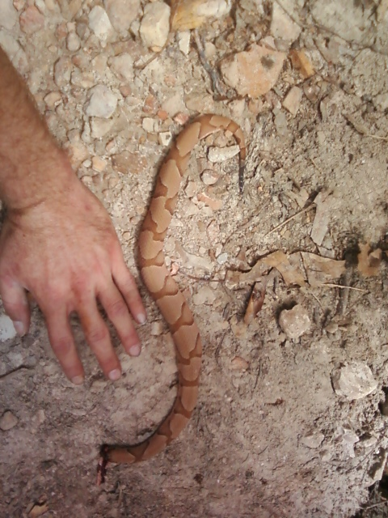
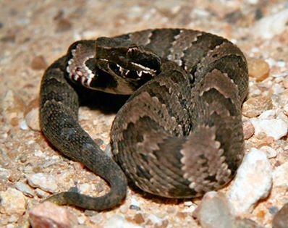
Be Aware

Slide 9
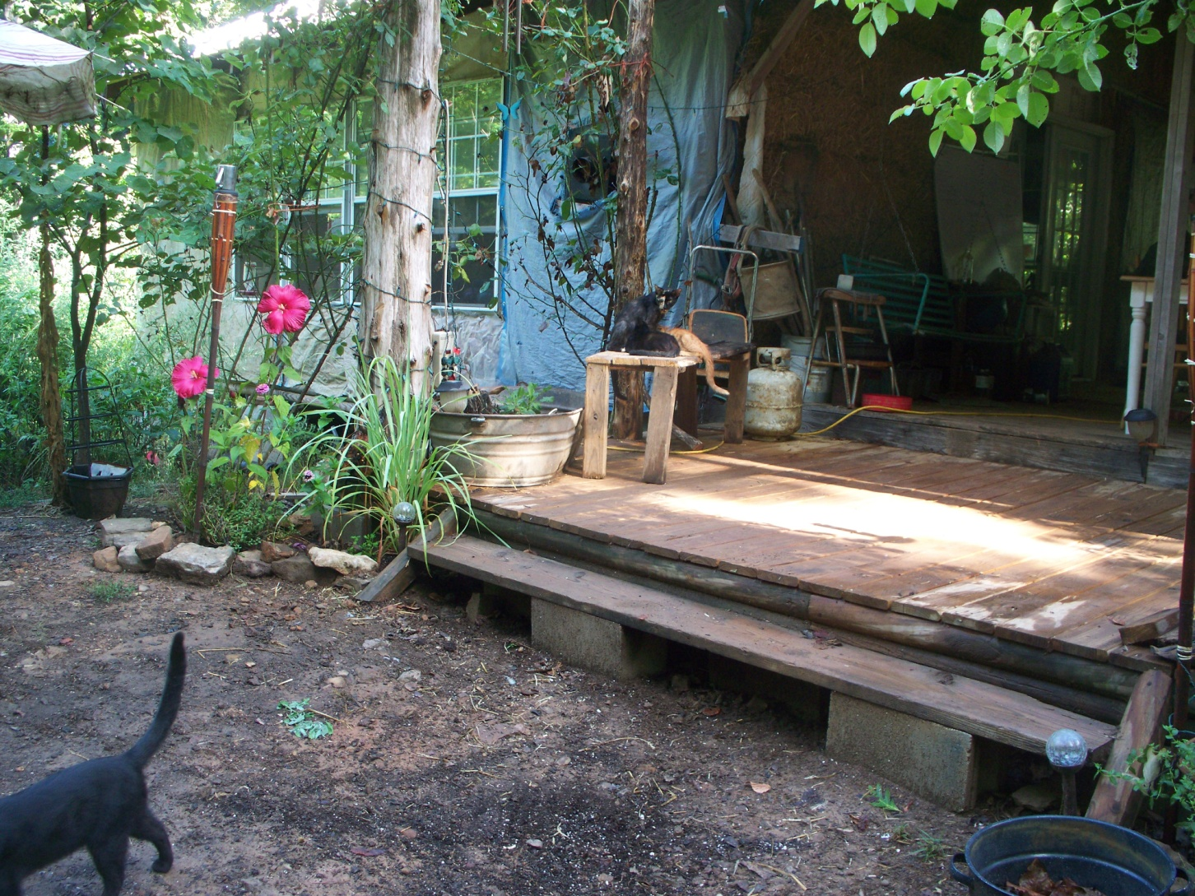
What is a Homestead?

Slide 10
What is a “Homestead”?
A homestead is” a place where a family makes its home”
“A tract of land granted by the US government to a settler”
Originally the government offered a certain number of acres to homesteaders who had to “prove up” by putting up a building and farming 10 acres by the end of the first year.

Slide 11
Current Concepts
Creating a family or community environment that uses resources in a sustainable manner, using less than is produced…

Slide 12
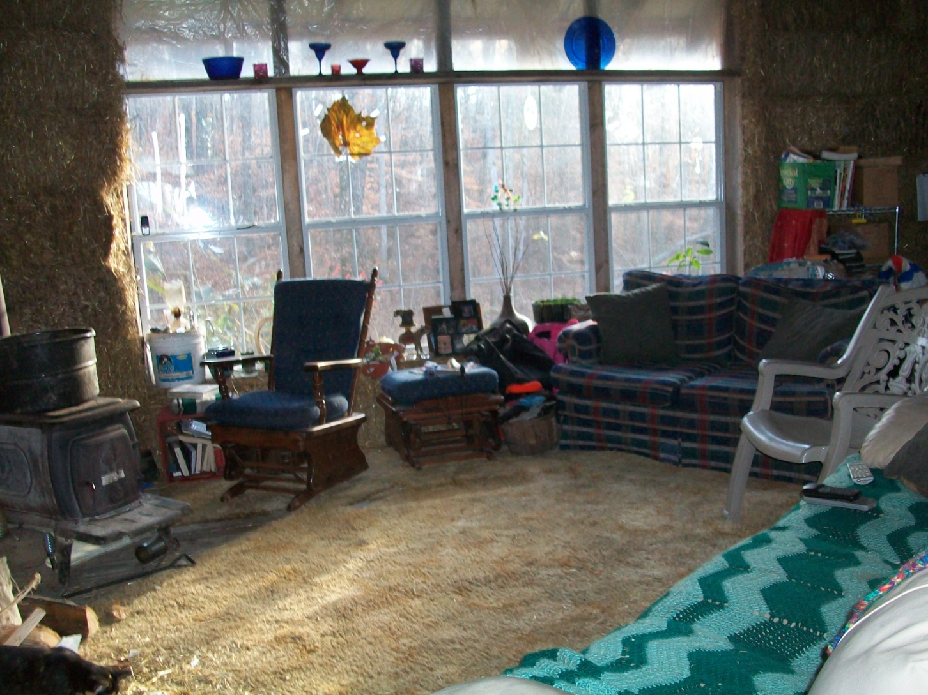
Why do it?

Slide 13
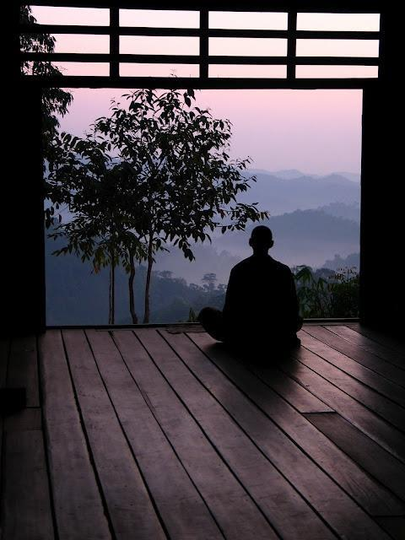

Slide 14
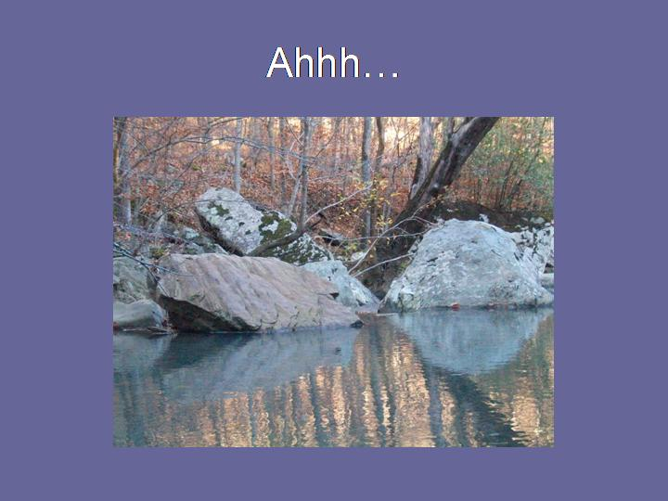

Slide 15
Multiple Reasons
Love of the out of doors
Self sufficiency
Financial security
Environmental concerns
Family Continuity

Slide 16
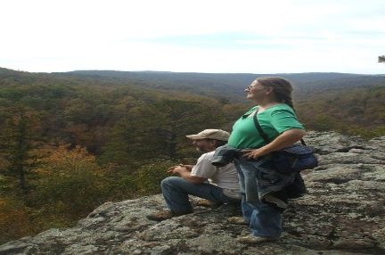
Love of the out of doors

Slide 17
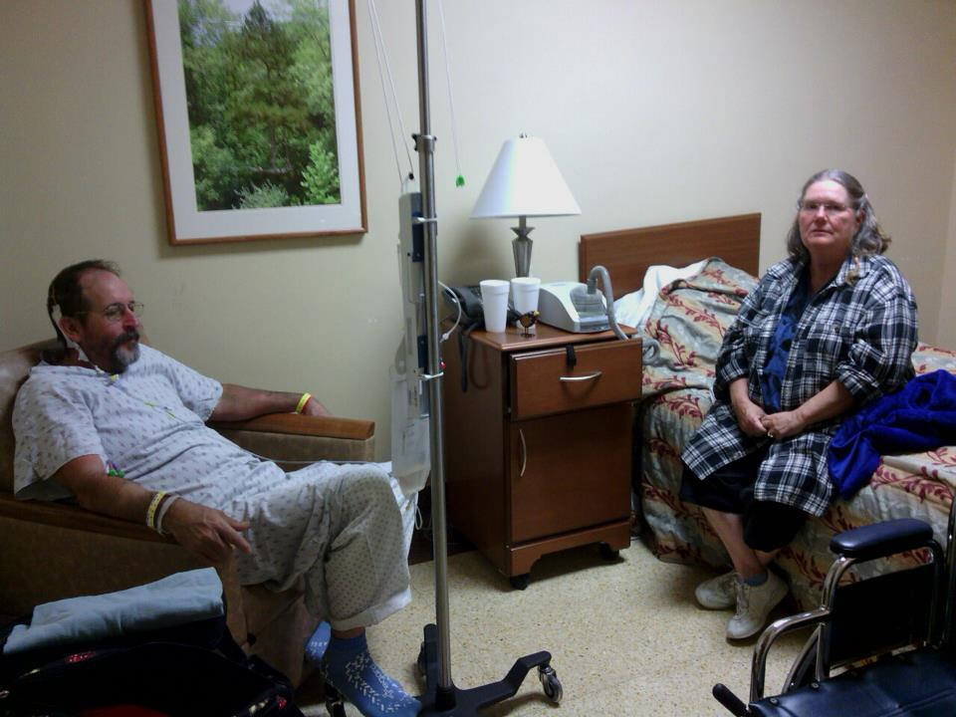
Illness and Medical Costs

Slide 18
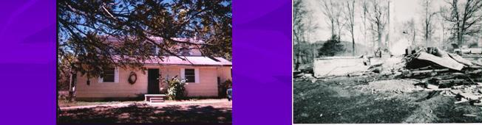
Financial

Slide 19
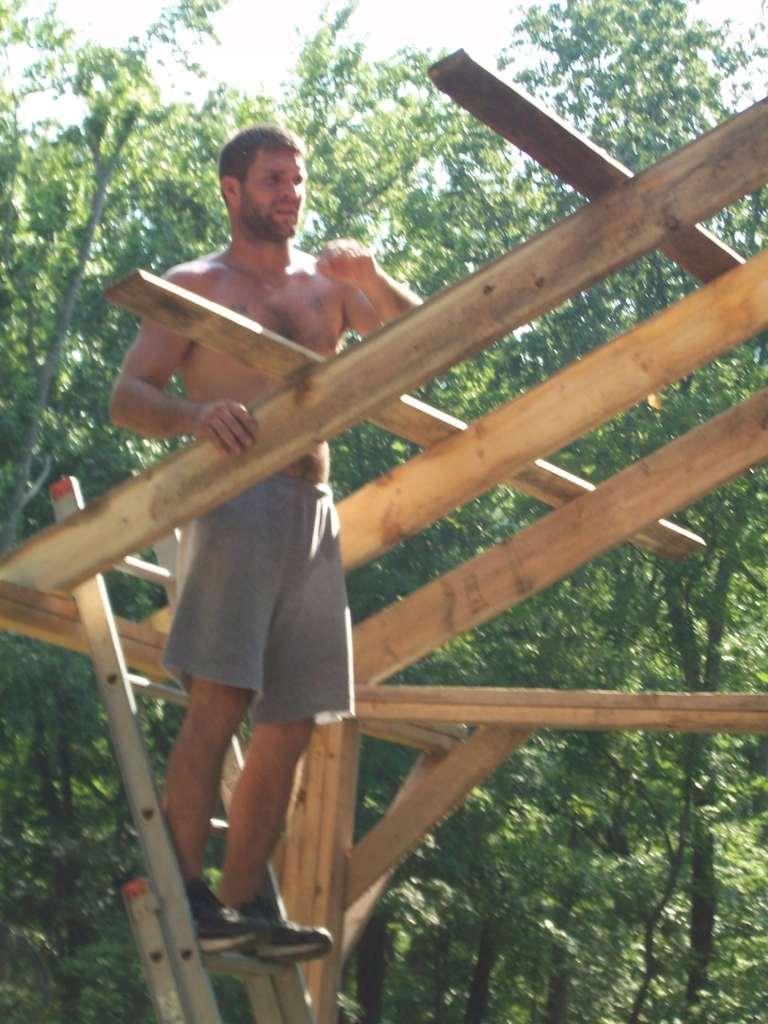
Self-Sufficiency

Slide 20
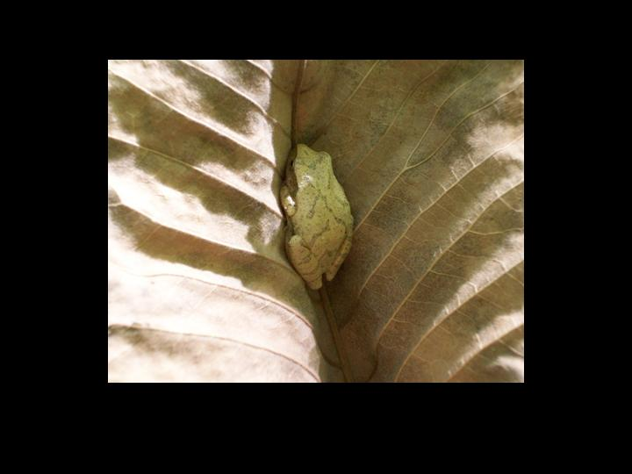
Environment

Slide 21
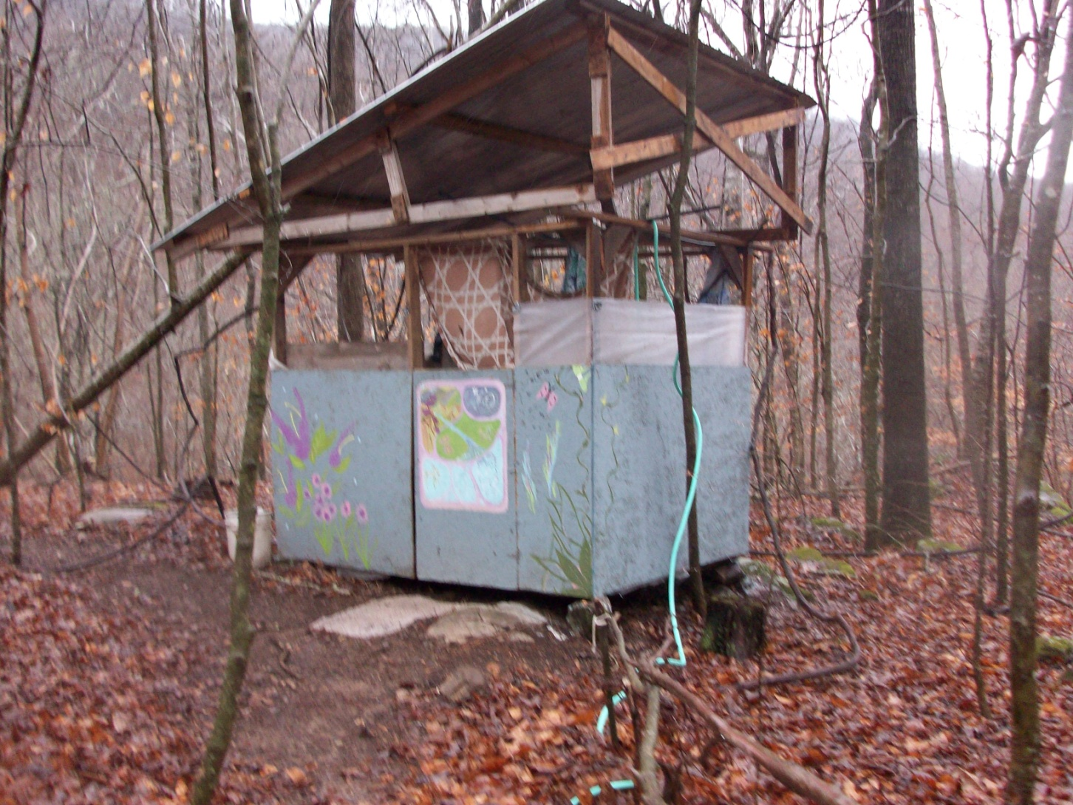
Environmental Concerns

Slide 22
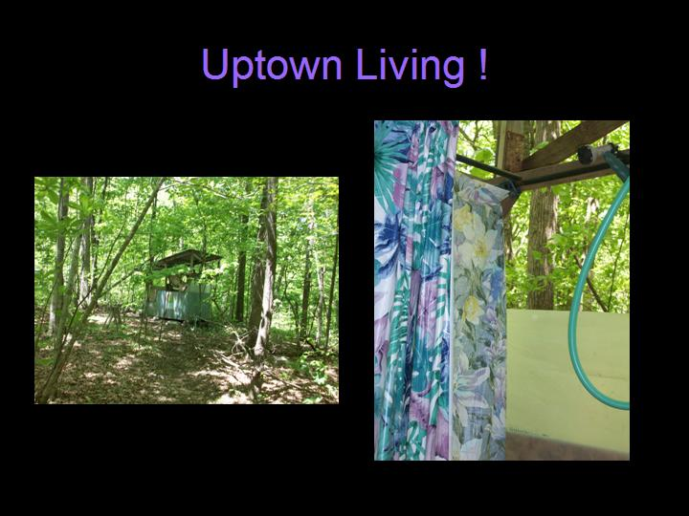

Slide 23
Ideals
Sustainability
Permaculture
Eco- Community
Carbon Footprint
Circle of Life

Slide 24
Sustainability
Often a “catch phrase”
But extremely important
Basic premise is meeting the needs of the present without compromising the ability of future generations

Slide 25
Best described as using with a deep awareness of the impact.
Building soil, creating resources rather than exhausting them. Producing as much , if not more than is consumed.

Slide 26
Permaculture
Permaculture is a way of designing all human systems so that they integrate harmoniously with the ecology.
An example is use of “zones”.

Slide 27
Eco-Community
A community with a shared goal of living in an ecologically responsible manner.

Slide 28
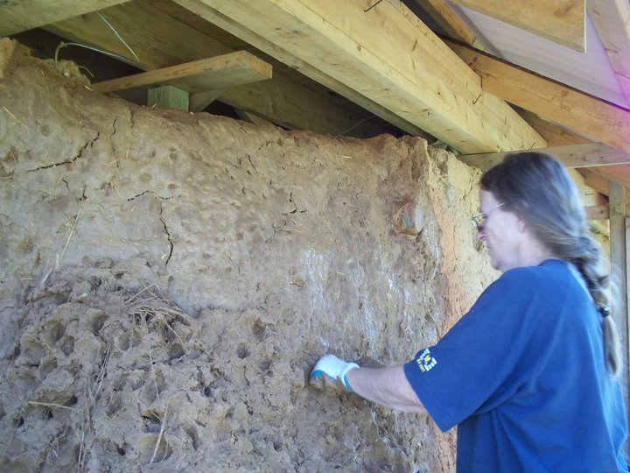

Slide 29
Explanation: Our goal is to create a culture where it is common practice for people to examine the full impacts of their actions. Examining the sum total of how we affect the Earth includes thinking about our impacts both present and future, and consideration of large scale as well as localized effects. Given this examination, people are then responsible for acting to maintain or increase the sustainability of the culture. By inquiring into the far-reaching and systematic effects of our actions as well as the visible and direct impacts we can better understand how to choose the more sustainable solution.

Slide 30
Carbon Footprint
The amount of environmental impact created by the activities of a person, group or corporation. Traditionally measured in the amount of carbon dioxide emitted, in building , it has come to mean the amount of energy consumed in the extraction, production and marketing of materials.

Slide 31
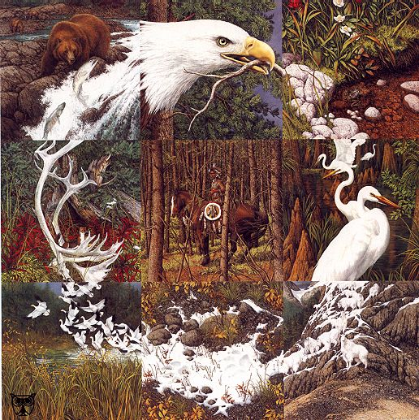
Circle of Life

Slide 32
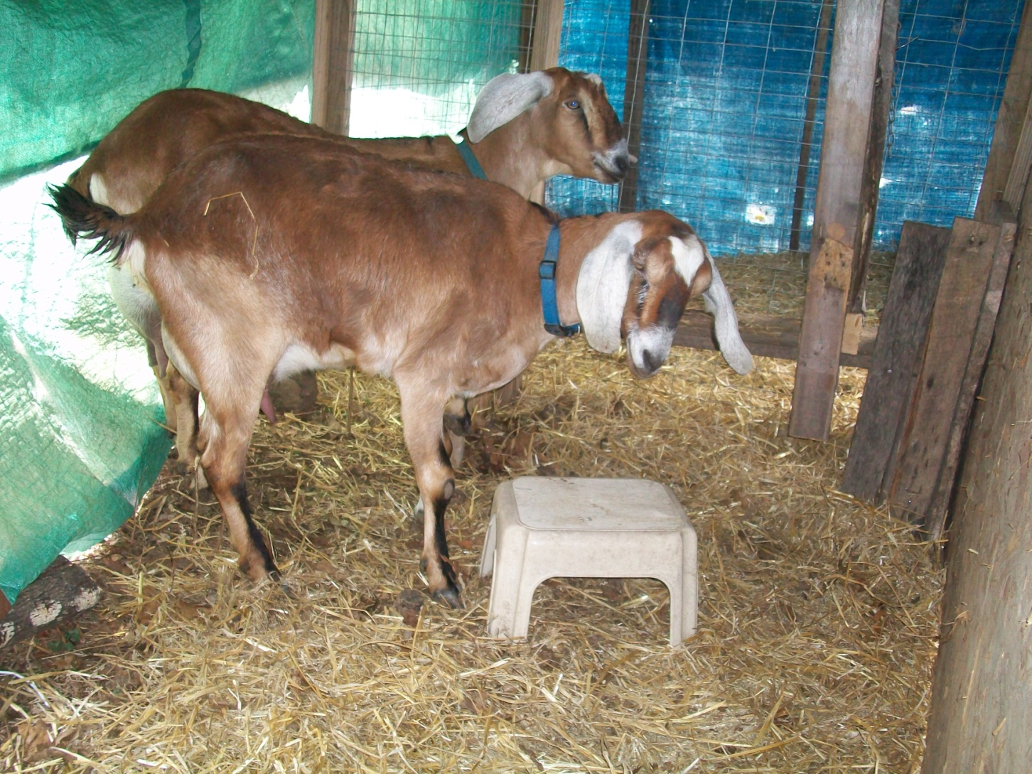
Nannies

Slide 33
Honesty
Be honest with yourself and your partner about WHAT you can and cannot deal with!

Slide 34
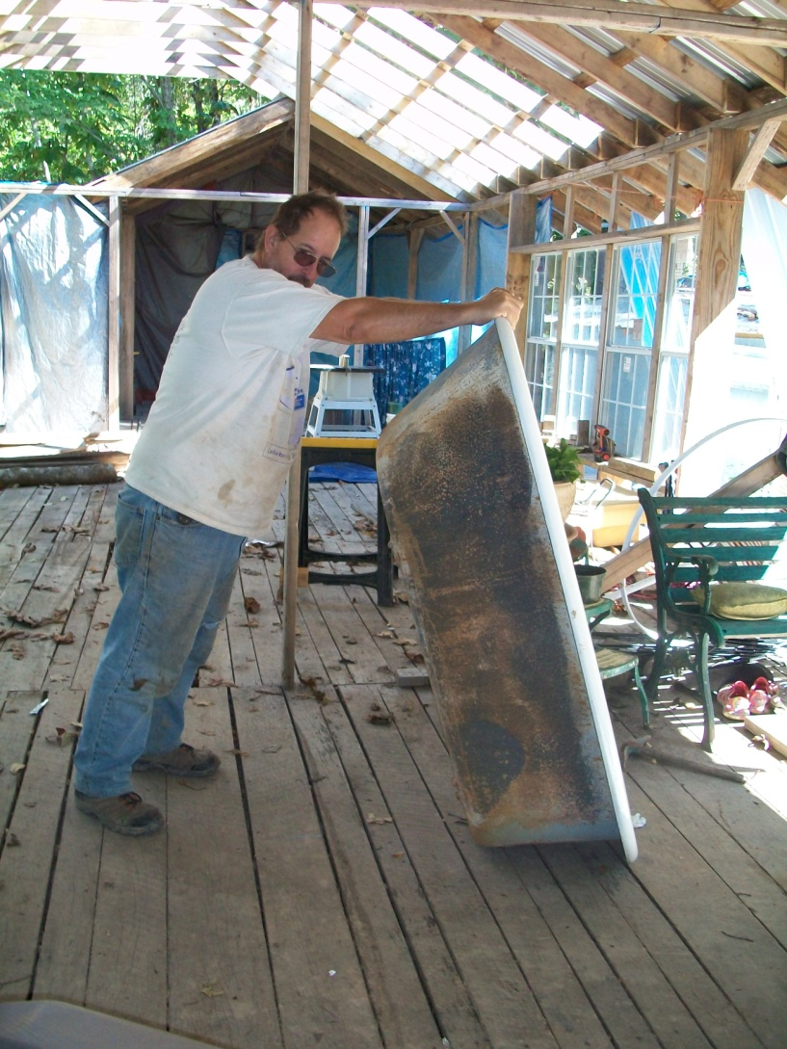
Hot Bath

Slide 35
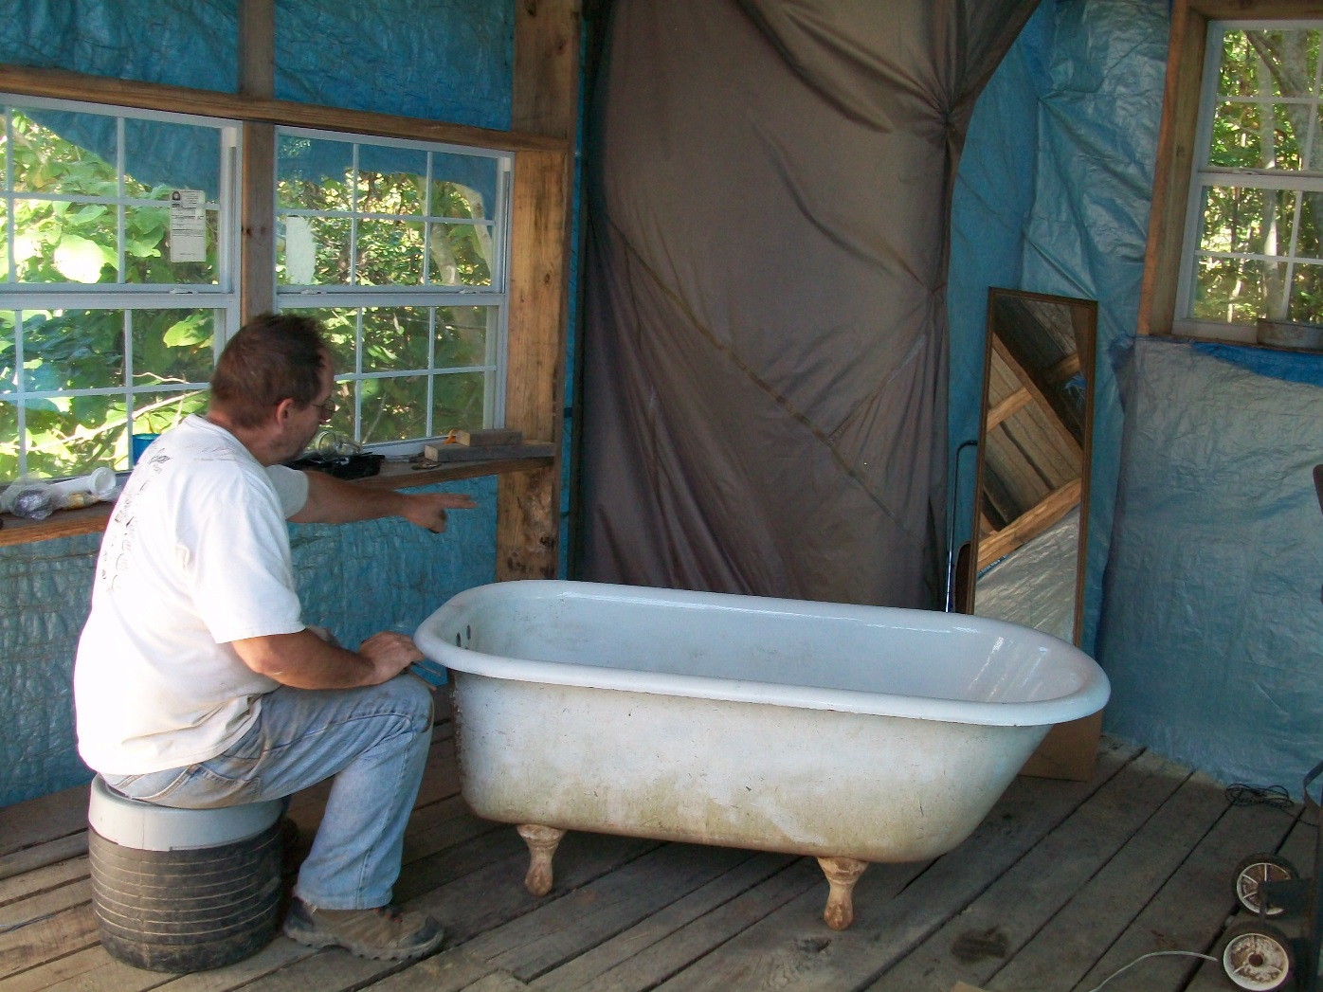

Slide 36
Flexibility-stuff happens…
Problem solving skills- think outside the box
Have specific goals- but stay Flexible ☺

Slide 37
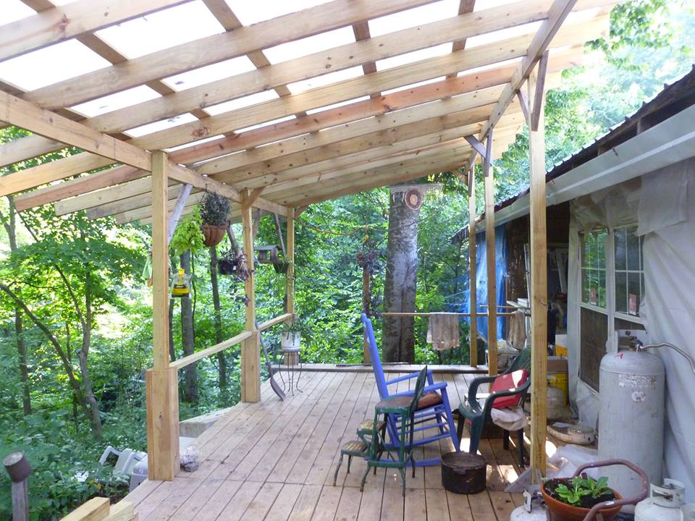

Slide 38
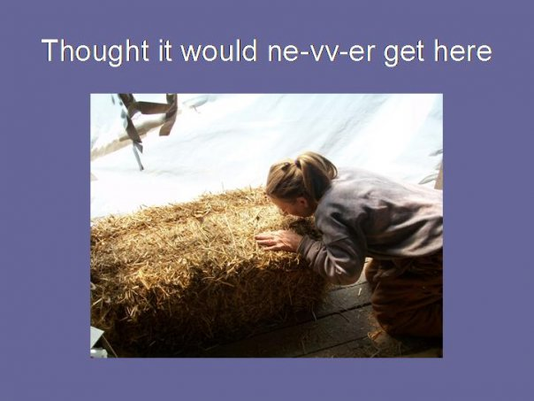

Slide 39
Financial

Slide 40
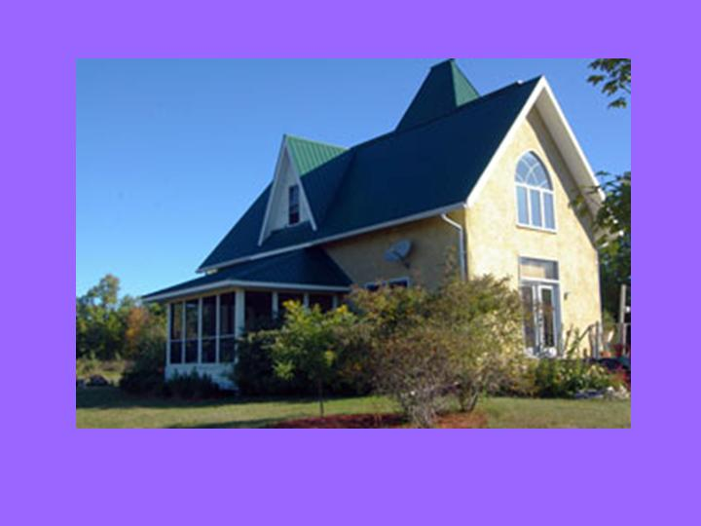
All at Once?

Slide 41
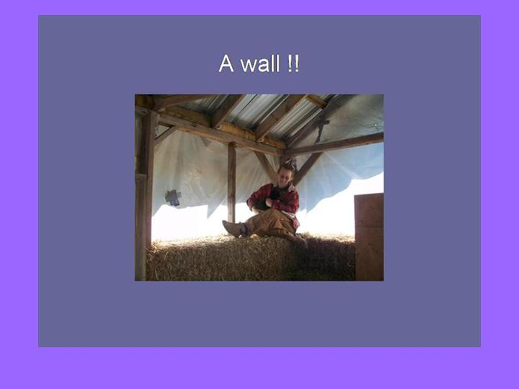
A Little at a Time?

Slide 42
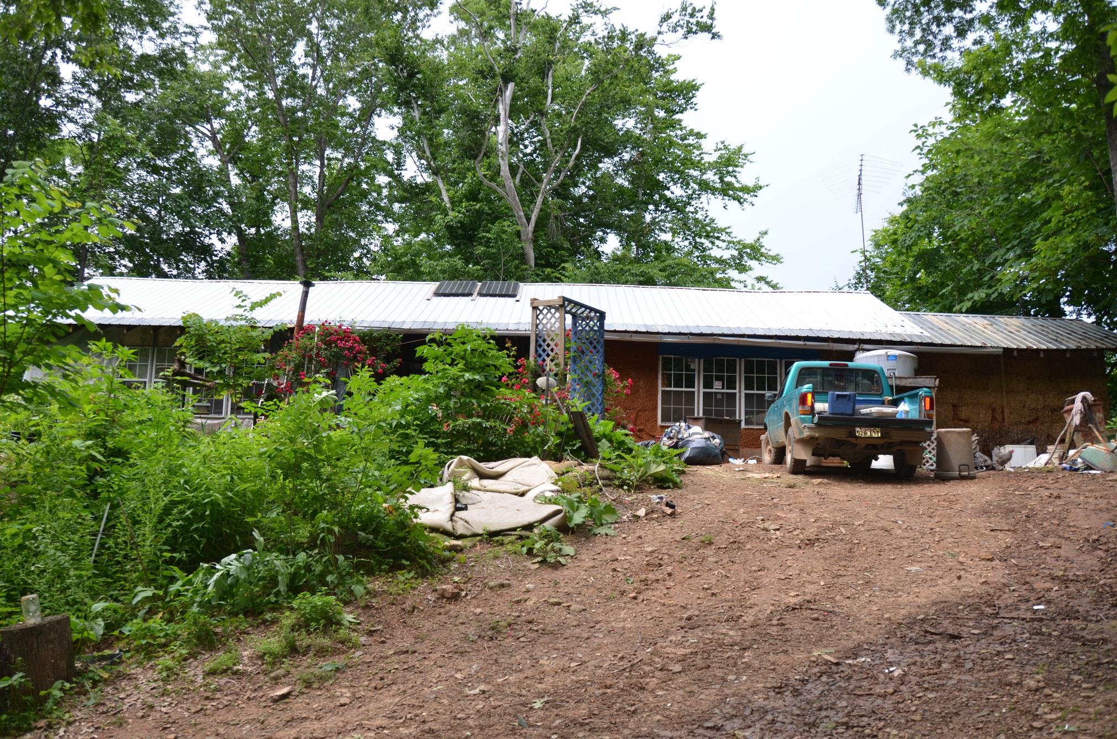

Slide 43
Water

Slide 44
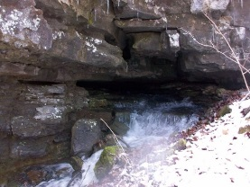

Slide 45
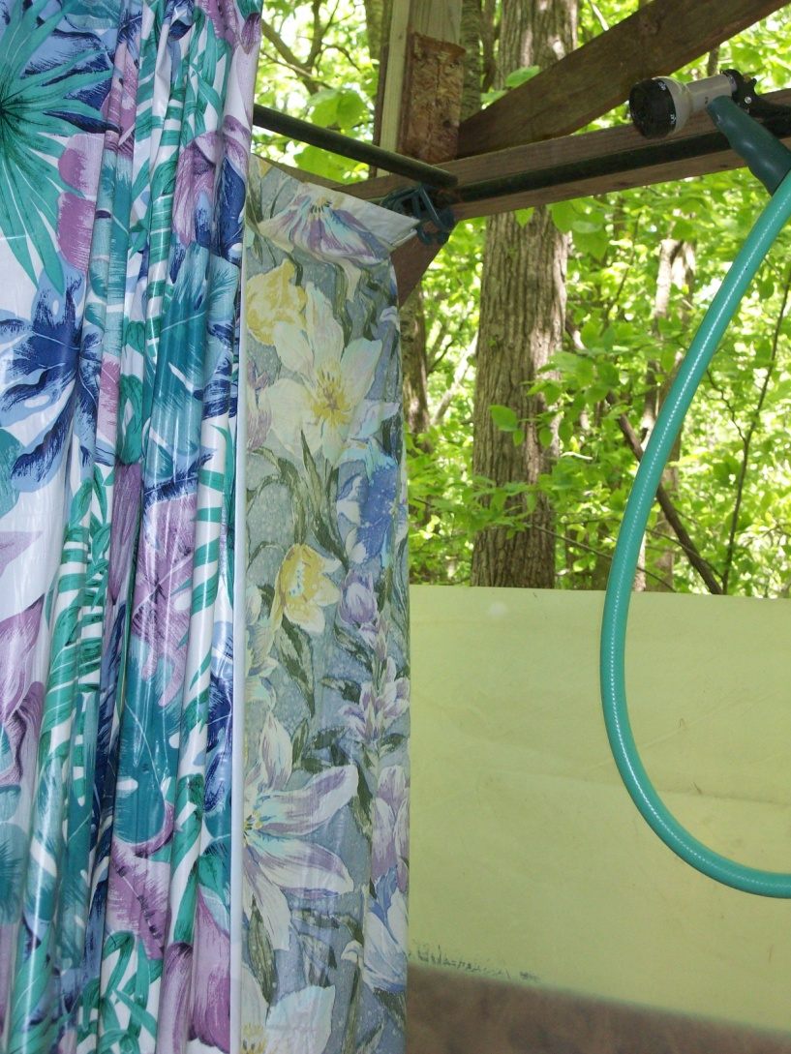
Ingenuity-gravity fed shower

Slide 46
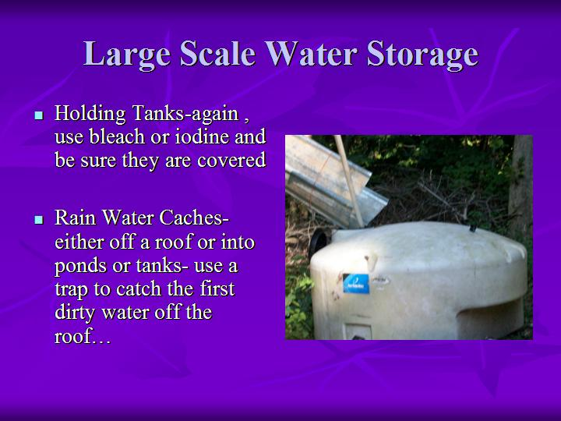

Slide 47
Shelter and storage

Slide 48
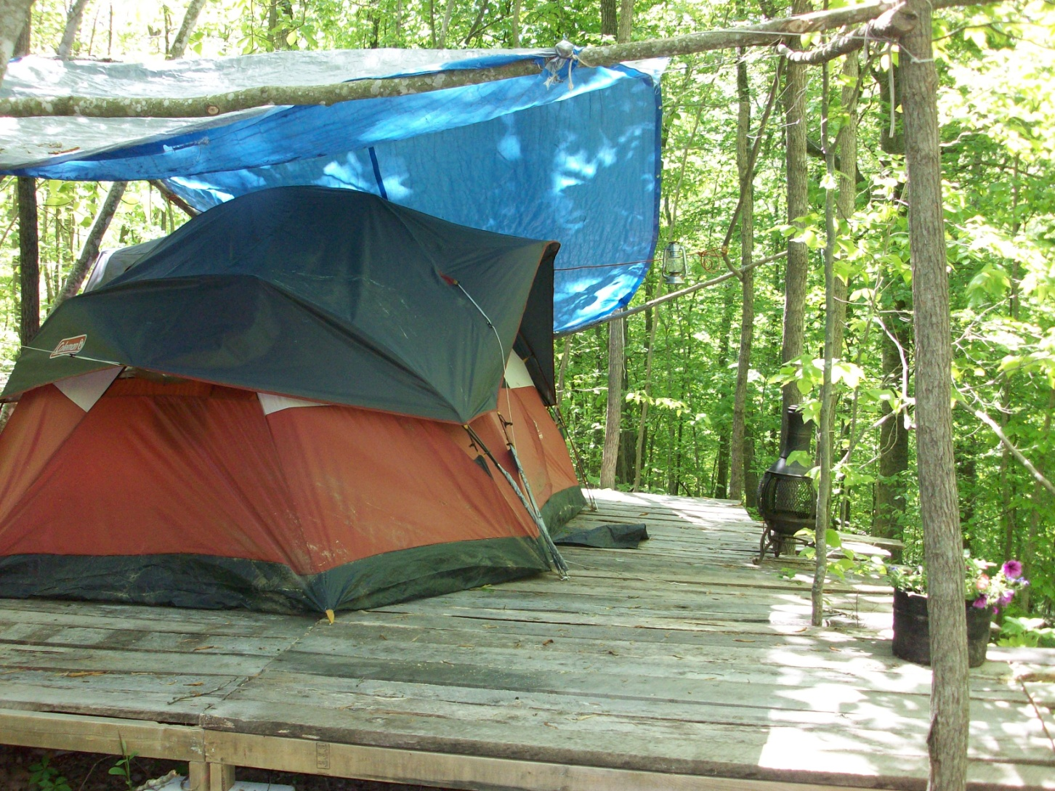
Temporary Quarters

Slide 49
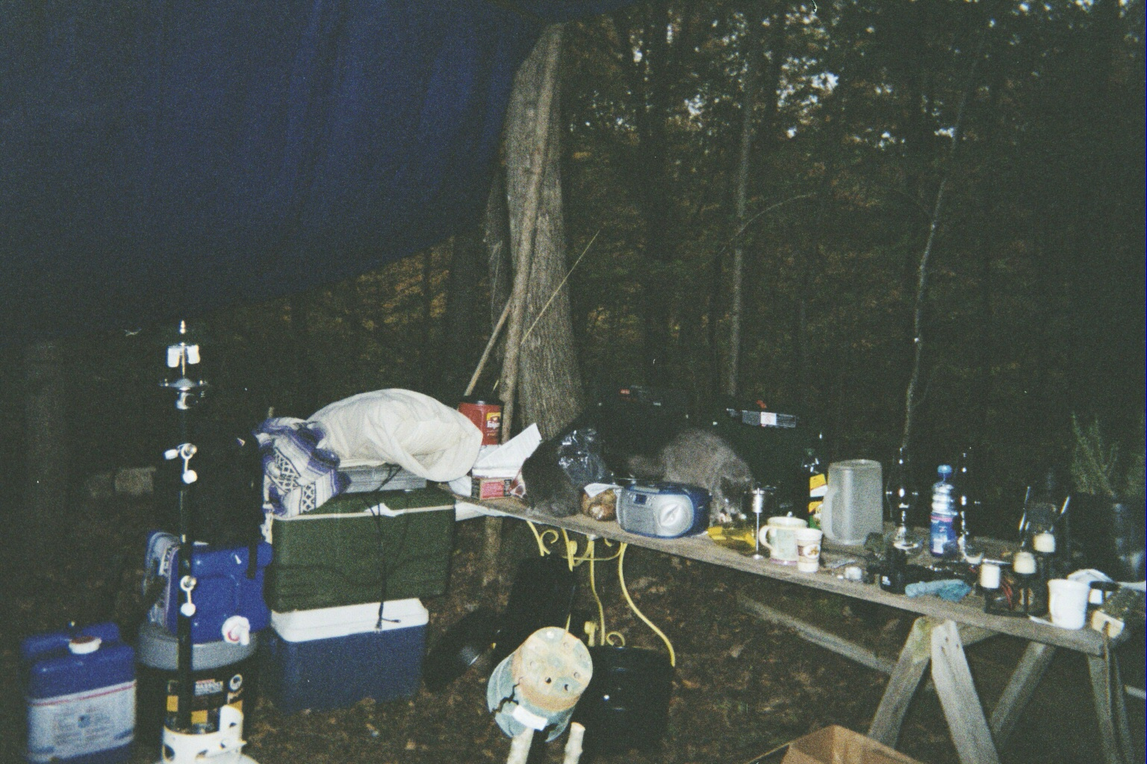
First Kitchen

Slide 50
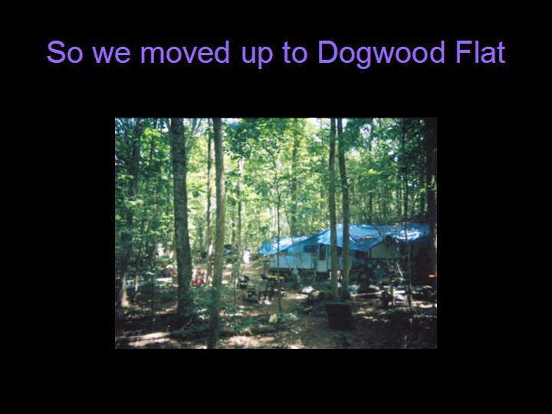

Slide 51
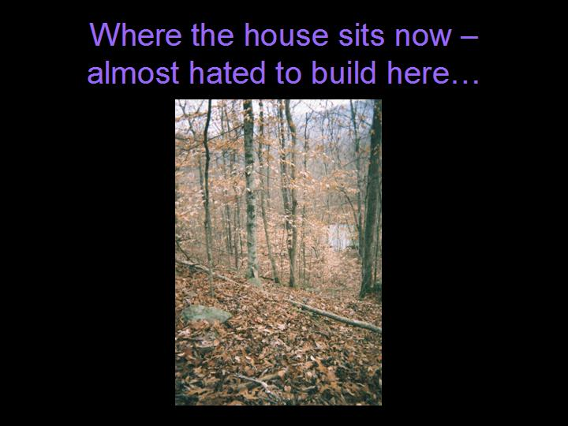

Slide 52
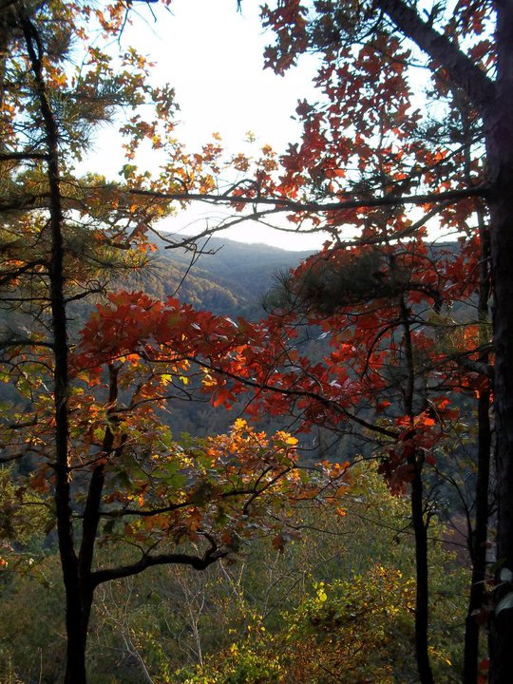
Best spot ☺

Slide 53
Access

Slide 54
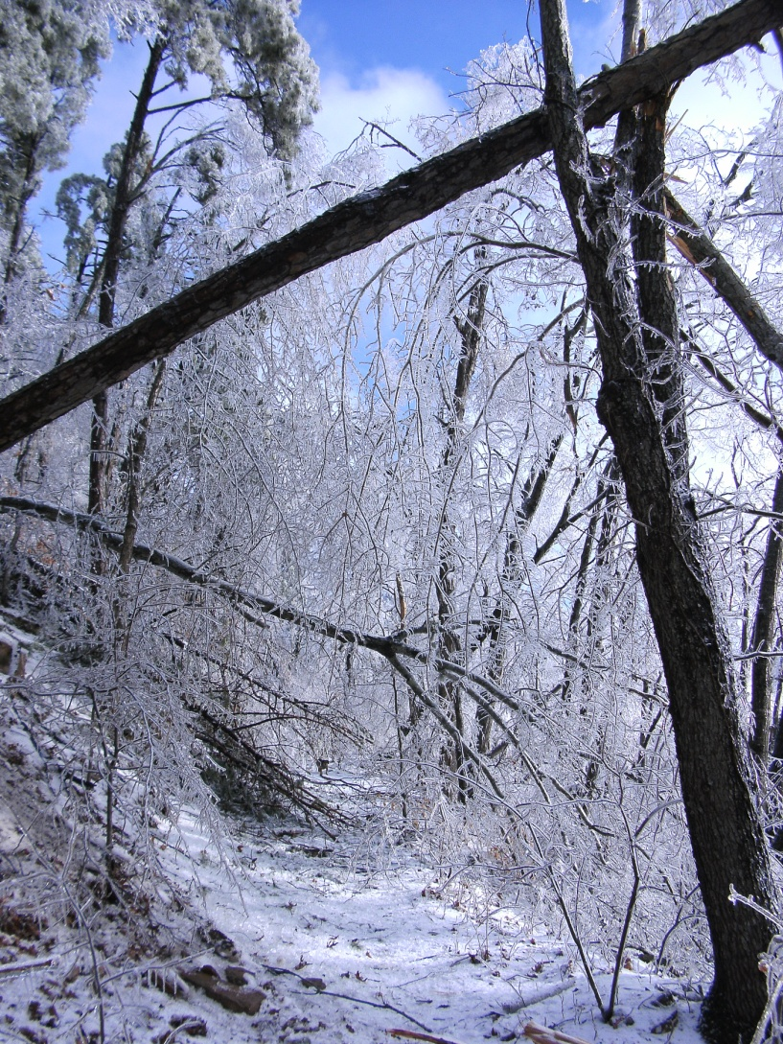
Access- ice storm

Slide 55
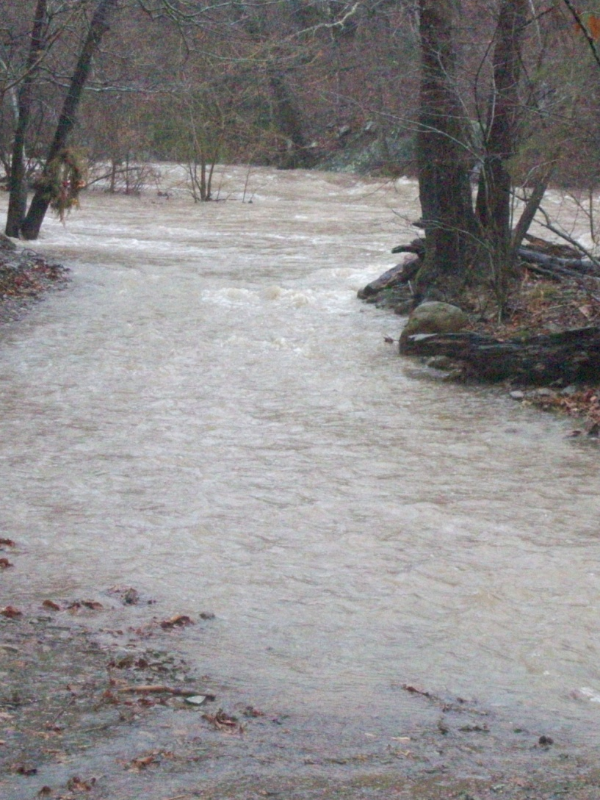
Access- flood stage- where’s the road?

Slide 56
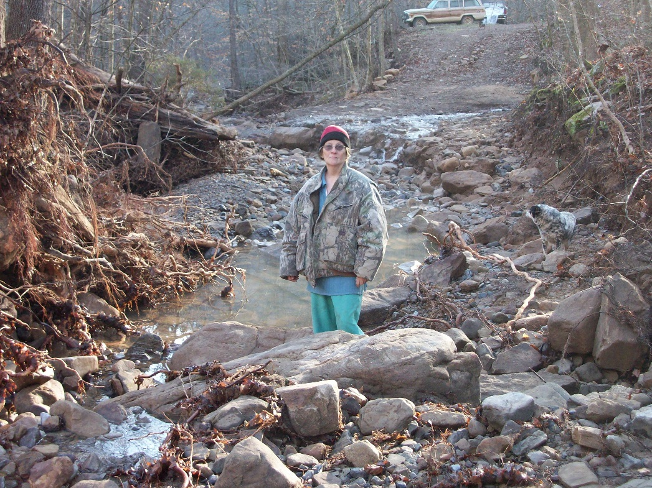

Slide 57
Energy and waste handling

Slide 58
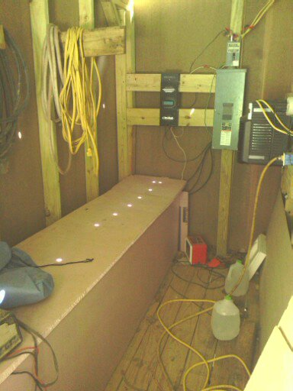
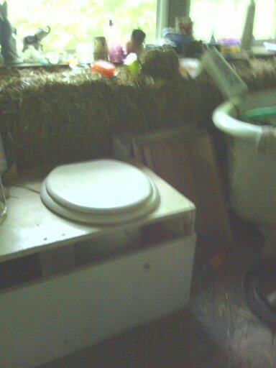
Energy and Waste

Slide 59
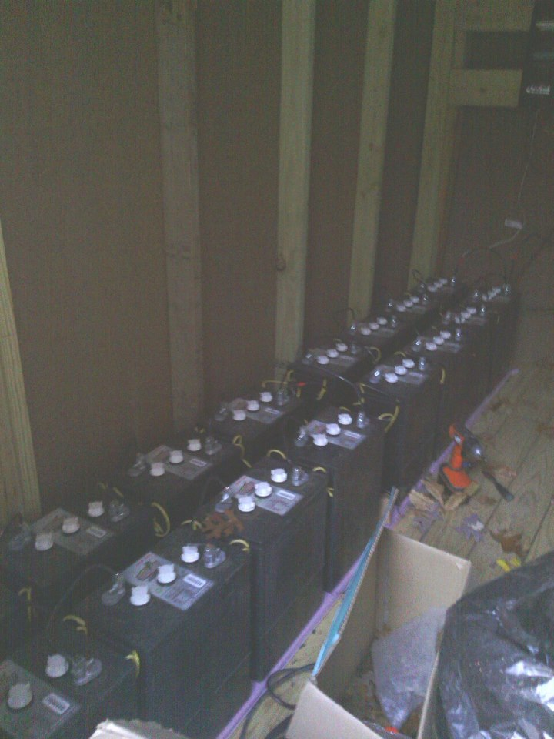

Slide 60
Net-working and help

Slide 61
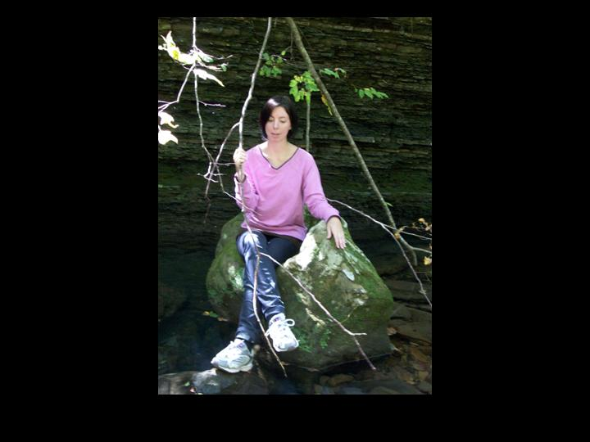
Help comes in all Forms

Slide 62
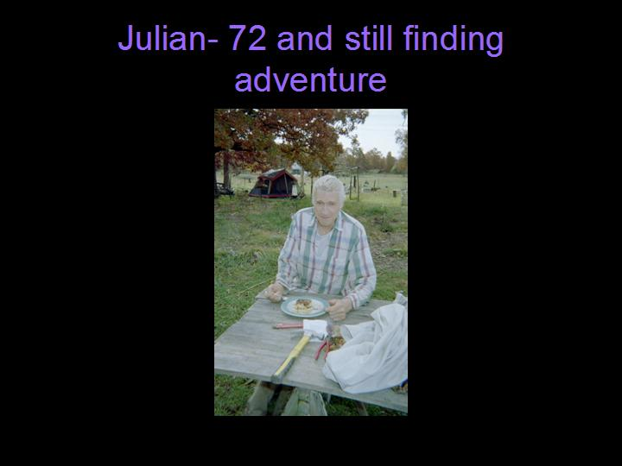
Age doesn’t change the face of help…

Slide 63
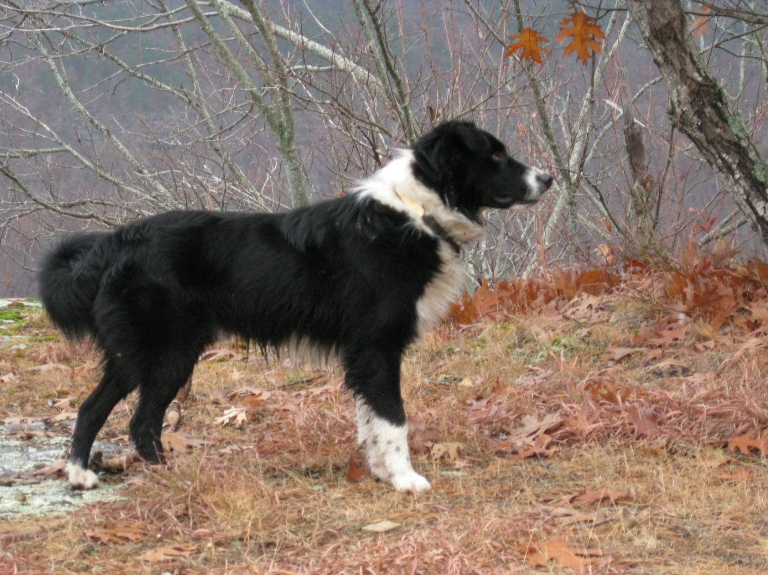
Helper’s

Slide 64
Skill set

Slide 65
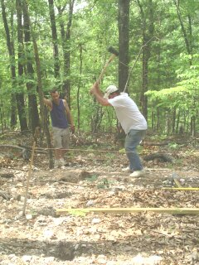

Slide 66
Skills that help
Starting a fire
Keeping a heat stove going
Concrete mixing
Gardening
Livestock
Carpentry
Plumbing
Fencing
Food storage
Orienteering
Engineering
Electrical
Research

Slide 67
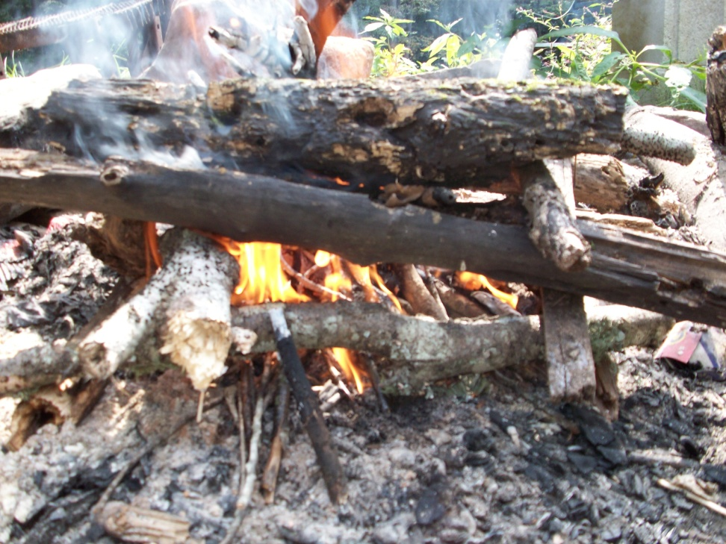

Slide 68


Slide 69


Slide 70
Food

Slide 71

Gardening

Slide 72


Slide 73


Slide 74


Slide 75


Slide 76


Slide 77

Medicinal Herbs

Slide 78

Mushroom Harvest-Accurate ID’s

Slide 79


Slide 80

Food preparation

Slide 81


Slide 82
Food Storage

Slide 83


Slide 84


Slide 85


Slide 86


Slide 87

Cellar, Pantry, Freezer,Smokehouse

Slide 88


Slide 89


Slide 90


Slide 91


Slide 92


Slide 93


Slide 94



Slide 95


Slide 96

Concrete work

Slide 97

Carpentry

Slide 98


Slide 99


Slide 100


Slide 101

Start to finish…

Slide 102


Plumbing

Slide 103
Electric

Slide 104
What do you need to plan on for power?

Slide 105

Orienteering

Slide 106


Slide 107


Slide 108

Create

Slide 109


Slide 110

Family Continuity

Slide 111


Slide 112
Claim it as
YOUR HOME!

Slide 113


Slide 114


Slide 115

Do things you Love

Slide 116


Slide 117

Find Beauty and Humor in
What is Around You

Slide 118


Slide 119


Slide 120


Slide 121


Slide 122


Slide 123


Slide 124

I know he’s up there!

Slide 125

HOME

Slide 126


